Slide 1
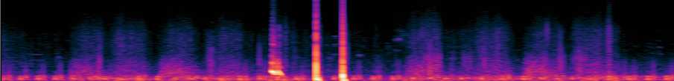
ML model (in case prediction model can’t be made)
Identify the regions in this sound file that corresponds to the breathing : - Targeted noise reduction
- Breathing features : Breathing intensity, Breathing rate
- Removal of mechanical tappings
- Integration with actuator
Cardiac
Talking
Cardiac
Event
Breathing
Tapping
Breathing
2000
Frequency (Hz)
1000
0
5
10
15
20
25
30
35
Time (s)

Slide 2
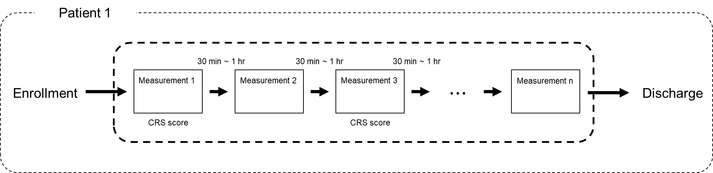
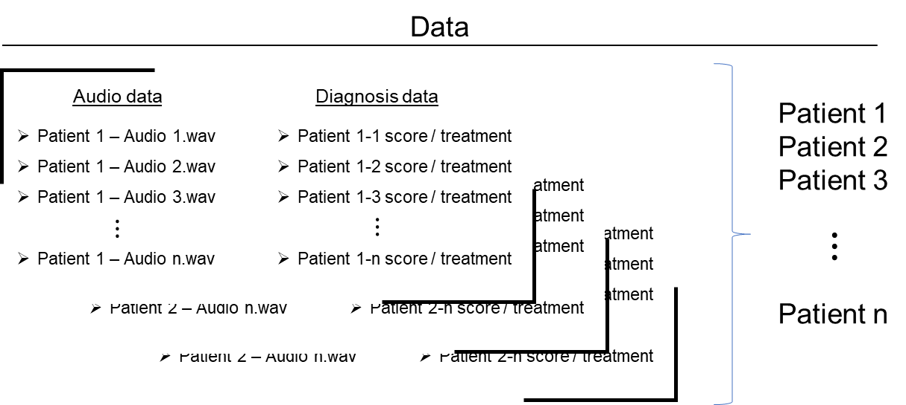
Patient Study Overview - CHOA
Number of Patients : 10
Age Range : 5 - 17
Data Collected : 1) Auscultation recordings 2) Medication prescription information 3) Clinical evaluation (CRS score)
ML applications : 1) Diagnostic classification 2) Prediction of progress

Slide 3
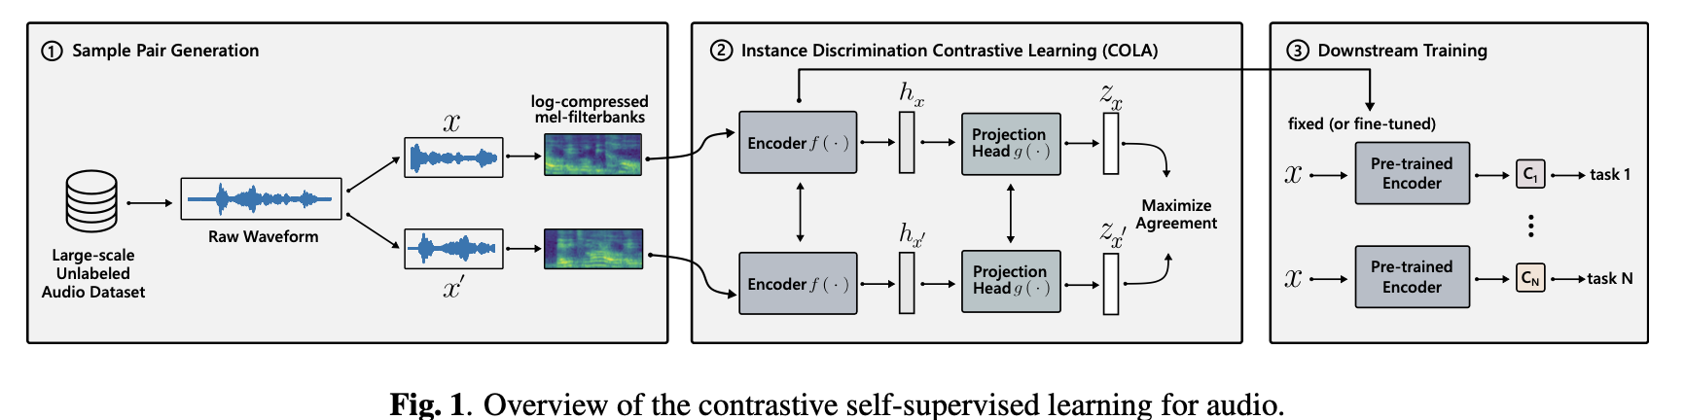
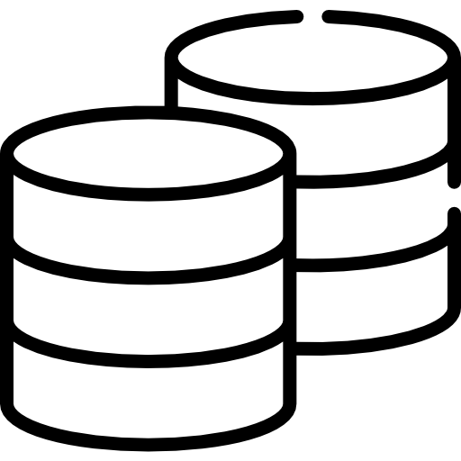

Open-source Based Pre-trained Models and Fine-tuning
Sample Pair Generation
Pre-training : Self-supervised learning
Model pre-acknowledges
Lung sound profiles
Dataset | Source
ICBHI 2017 | ICBHI
HF_Lung | TSECC
KAUH | KAUH
Pulmonary (Lungs) Sound | Fortis
SPRSounds | UoC
Coswara | IISc
Transfer learning / Fine-tuning
Pre-trained Encoder
Output
Clinical audio data
Classical approach
Without pre-training
Effect of using pre-trained model : Lesser data, yet, higher performance
 | Without pre-trained model | With pre-trained model
Size | 136K samples, 400+ hours | 21K samples, 100+ hours
Performance (AUROC) | 0.933 ± 0.005 | 0.954 ± 0.006
Task : Diagnostic classification of open-source data

